Slide 1


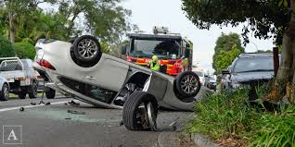
NSW Road crashes
Team Members:
Peter Kapsalis,
Jackson Sandler,
Anthony Tran,
Evgeniia Kozodeeva

Slide 2
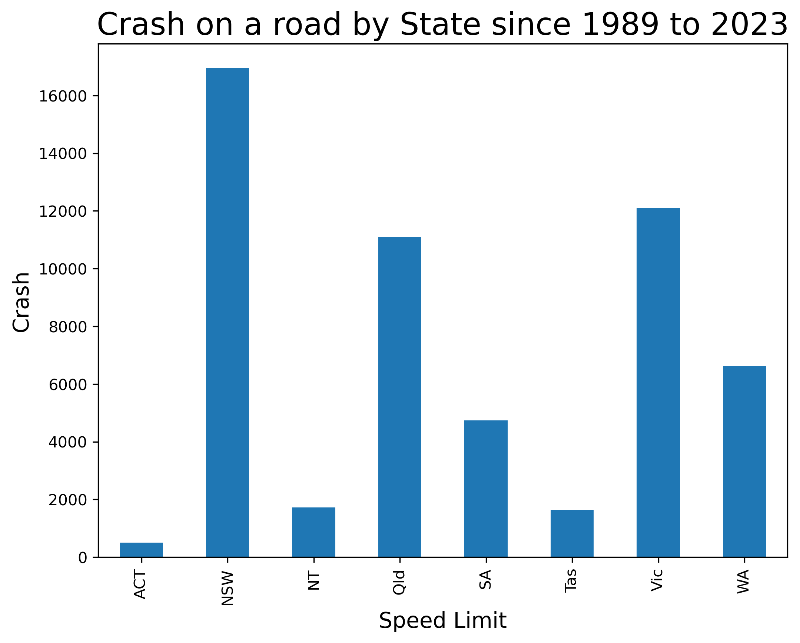
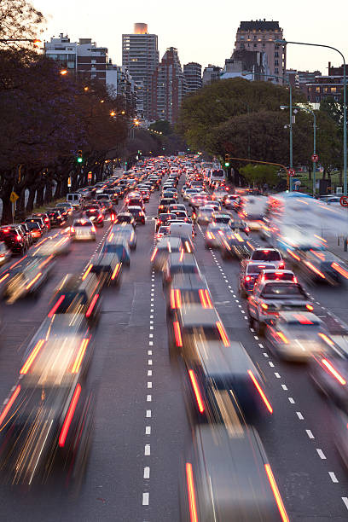
What is happening on the roads of Australia?

Slide 3
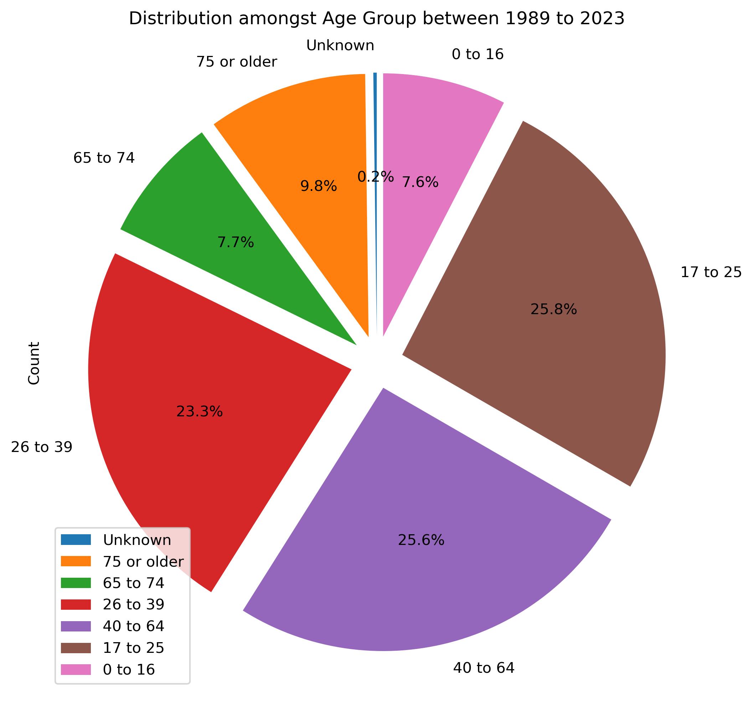
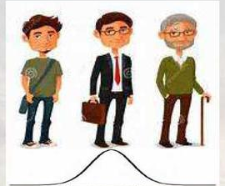
Demographic Factors Age

Slide 4
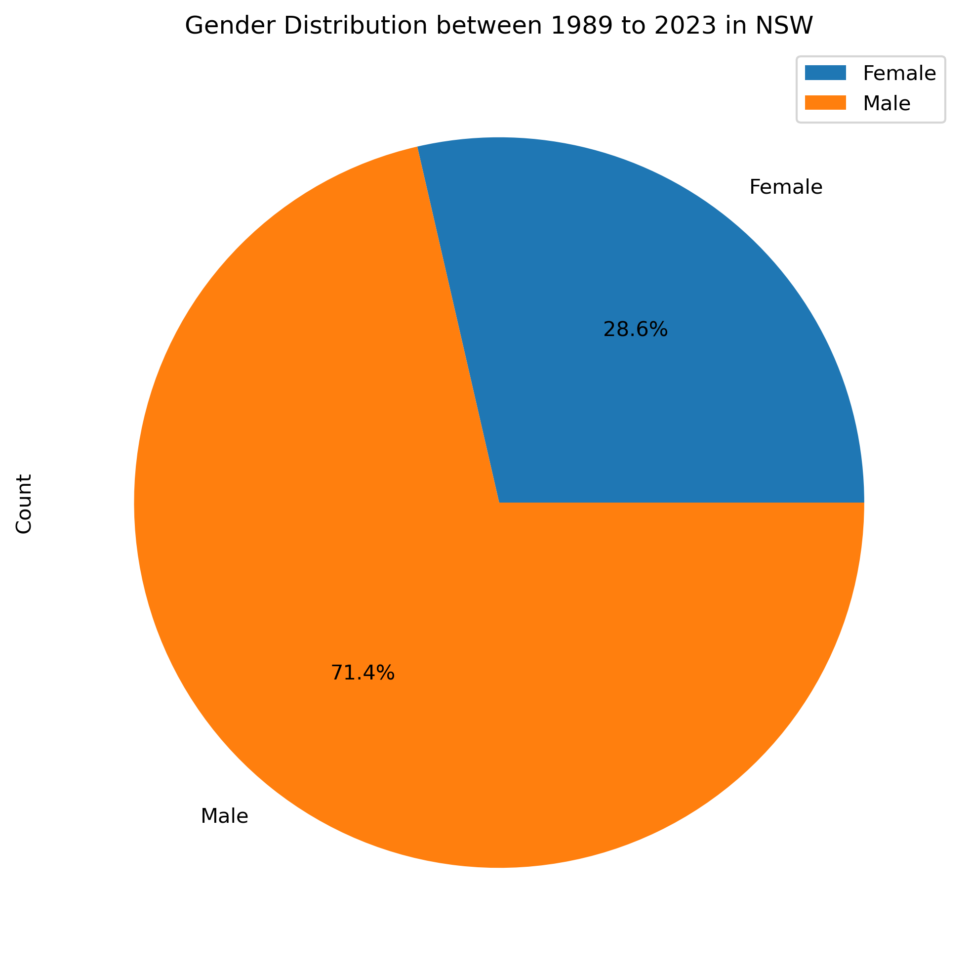

Demographic Factors Gender

Slide 5
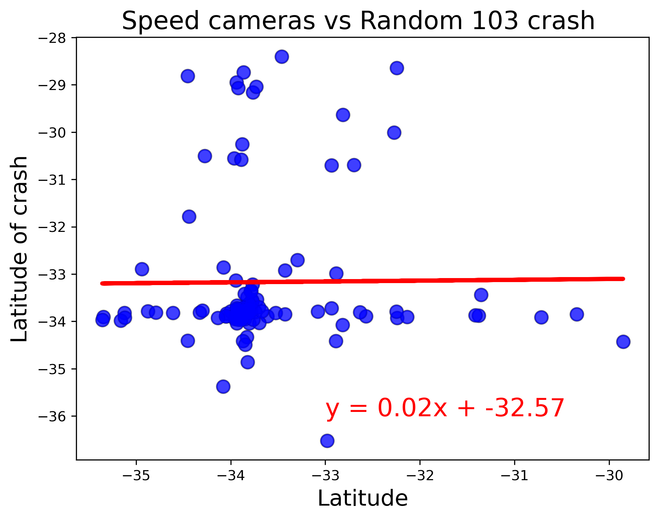

Traffic cameras and Crashes
over 1,240 red light and speed cameras
No linear relationship. It is mean the speed camera help to avoid crash.

Slide 6
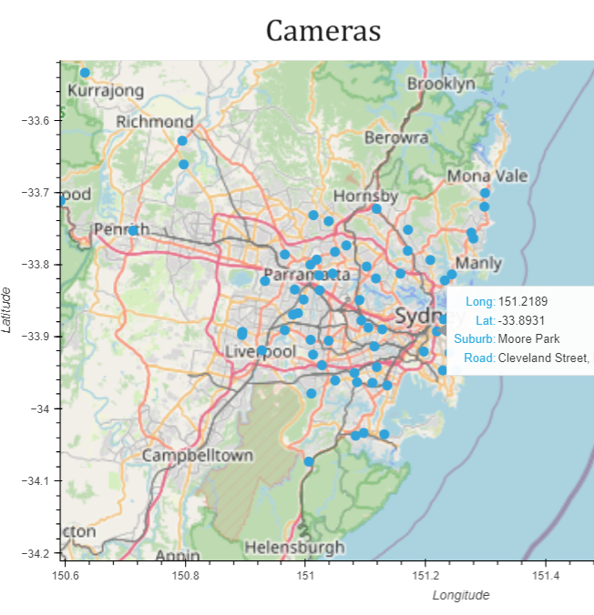
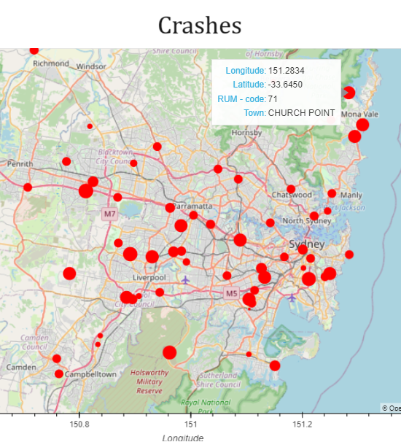
Geo mapping Crash and Cameras

